Slide 1
COMPUTING RESEARCH PROJECT
Ms. Sajeetha
Lecturer IT

Slide 2
L01 Examine appropriate research methodologies and approaches as part of the research process
What is research?
Objectives/ Purposes of Research
The importance of developing a methodical approach and discussing the benefits
How to Develop a Research Proposition?
Saunders’ Research Onion (Research philosophies)
How to write Research Questions (Dependent and independent variables)
Write your Theory
How to write your Theoretical gap
How to write the Hypothesis

Slide 3
What is Research?
There is various definition of Research by various researchers, as per the fields of their study and the availability of resources at the given time. As a basic definition of Research, we can say Research is the process of gathering information and data to discover a new knowledge/concept or advancement of existing theories, which is a new understanding that was not previously known.
According to (Rocco, 2011), "Research is a careful investigation or inquiry especially through search for new facts in any branch of knowledge." Research is a movement from the known to the unknown (Redman and Mory, 2010).
Also, Research is a scientific approach of answering a research question, solving a problem or generating new knowledge through a systematic and orderly collection, organization, and analysis of information with an ultimate goal of making the research useful in decision-making.

Slide 4
When defining the Research the following terms must be understood also
Research is a continuous activity in majority of disciplines and professions
It is helpful in critical assessment of the way we work, execute policies, and give instructions in our professions
It is a systematic observation of processes to find better ways to do things and to reduce the effort being put in to achieve an objective and identifying the validity of the targets
In fact, research is a subconscious activity that we are involved in at all times whether it is purchase of daily use articles , a car, an electronic good or planning a holiday

Slide 5
“Research is a Systematic Process that creates new Knowledge“
Notes:
Systematic process – It is a defined set of procedures/ methodology or steps that is followed nd developed after decades of reseachers to achieve the objective

Slide 6
Systematic research in any field of inquiry involves three basic operations
1. Data collection: It refers to observing, measuring, and recording information.
2. Data analysis: It refers to arranging and organizing the collected data so that we may be able to find out what their significance is and generalize about them.
3. Report writing: It is an inseparable part and a final outcome of a research study. Its purpose is to convey information contained in it to the readers or audience.

Slide 7
Some ways in which the term Research is used wrongly
Just collecting facts or information with no clear purpose,
Reassembling and reordering facts or information without interpretation.
As a term to get your product or idea noticed and respected

Slide 8
When you need to conduct Research Study?
To students who are to write a master’s or PhD thesis, research may mean a way to attain a high position in the social structure.
Research is important for researchers in studying social relationship and in seeking answers to various social problems.
Research provides the basis for nearly all government policies in our economic system.
Research has its special significance in solving various operational and planning of business and industry.
Research is needed to develop strategies and models in rural development.
The role of research in several fields of applied economics, whether related to business or to the economy as a whole, has greatly increased in modern items.
Research inculcates scientific and inductive thinking and it promotes the development of logical habits of thinking and organization.
To professionals, research may mean a source of livelihood.
To analysts and intellectuals, research may mean the generalizations of new theories. Thus, research is the foundation of knowledge for the sake of knowledge and an important source for providing guidelines for solving different business, government and social problems

Slide 9
Characteristics of a Good Research
Characteristics of research determine whether a research is free of biases, prejudices, and subjective errors or not. The terms are very commonly used in research and the success of any research depends on these terms. They can be summarized as following terms:
1. Generalized
2. Controlled
3. Rigorous
4. Empirical
5. Systematic
6. Reliability
7. Validity
8. Employs hypothesis
9. Analytical & Accuracy
10. Credibility
11. Critical

Slide 10
What is the purpose of research
The principal objective or purpose of research in any field of inquiry is to add to what is known about the phenomenon under the investigation through the application of scientific methods. The purpose of research is the following
1. Exploratory: Exploratory research is the first unstructured research for solving new problems that haven’t been explored/discovered before.
As the name suggests, researchers conduct exploratory studies to explore a group of questions. The answers and analytics may not offer a conclusion to the perceived problem. It is undertaken to handle new problem areas that haven’t been explored before. This exploratory data analysis process lays the foundation for more conclusive data collection and analysis.
Notes:
Exploration: Exploration is finding out about some previously unexamined phenomenon.
It is particularly useful when researchers lack a clear idea of the problems they will meet during the course of the study. Through exploration, researchers –
• Develop concepts more clearly
• Establish priorities .
• Develop operational definitions
• Formulate research hypotheses, and
• Improve the final research design. Explorative studies tend toward loose structures with the objective of discovering future research tasks. One might think, for example, of initiating an exploratory research in the following situations –
• Crime is increasing in the city at an alarming rate, the reasons for which remain unknown. The problem is ambiguous and what is actually happening is to be cleared.
• A new product is to be marketed, the manufacturer remains in worry if the product will be accepted by the people or not.

Slide 11
2. Descriptive: Descriptive research expands knowledge of an existing research problem in a structured way.
It focuses on expanding knowledge on current issues through a process of data collection. Descriptive research describe the behavior of a sample population.
Only one research variable is required to conduct the study. The three primary purposes of descriptive studies are describing, explaining, and validating the findings.
For example, a study conducted to know if top-level management leaders in the 21st century possess the moral right to receive a considerable sum of money from the company profit.
Notes:
Description refers to the data based information-gathering activities. The situations
and events which are described through studies are referred to as descriptive studies. Descriptive
studies try to discover answers to the questions who, what, when, where and sometimes how.
A descriptive study may be feasible in the following cases -
• What are the characteristics of the people who are involved in city crime? Are they young?
Middle aged? Poor?
• Who are the potential buyers of the new product? Men or women? Urban people or rural people?

Slide 12
What is the purpose of research
3. Explanatory: Explanatory research is a casual and experiential research. It is conducted to check the result of specific changes in an existing procedure or system.
Causal research or explanatory research is conducted to understand the impact of specific changes in existing standard procedures. Running experiments is the most popular form. For example, a study that is conducted to understand the effect of rebranding on customer loyalty.
Notes:
An explanatory study goes beyond description and attempts to establish causeand-effect relationship between variables. It explains the reason for the phenomenon that describes study observed. Thus, if a researcher finds that communities having higher family size have higher child death, s/he is performing a descriptive study. If researcher is explaining why it is so and tries to establish cause-and-effect relationship, s/he is performing an explanatory study. Such studies are also called causal studies. Following examples fit to causal studies - • Why people are involved in crime? Can we explain this as a consequence of present crisis in the job market? Or for lack of parental care? • Will buyers be motivated to purchase the new product in a new container? Can attractive advertisement motivate them?

Slide 13
Here is a comparative analysis chart for a better understanding
 | Exploratory Research | Descriptive Research | Explanatory Research
Approach used | Unstructured | Structured | Highly structured
Conducted through | Asking questions | Asking questions | By using hypotheses.
Time | Early stages of decision making | Later stages of decision making | Later stages of decision making

Slide 14
It begins by asking the right questions and choosing an appropriate method to investigate the problem. After collecting answers to your questions, you can analyze the findings or observations to draw reasonable conclusions.
To make sense of your study and get insights faster, it helps to use a research repository as a single source of truth in your organization and manage your research data in one centralized data repository.

Slide 15
8 tips for conducting accurate research
Identify the main trends and issues, opportunities, and problems you observe. Write a sentence describing each one.
Keep track of the frequency with which each of the main findings appears.
Make a list of your findings from the most common to the least common.
Evaluate a list of the strengths, weaknesses, opportunities, and threats identified in a SWOT analysis.
Prepare conclusions and recommendations about your study.
Act on your strategies
Look for gaps in the information, and consider doing additional inquiry if necessary
Plan to review the results and consider efficient methods to analyze and interpret results.

Slide 16
Computing Research Project Brief

Slide 17
Computing Research Project Brief
Define your research problem or question. This can be stated as a research question, objectives or hypothesis.
Provide a literature review giving the background and conceptualization of your proposed area of study. This would provide existing knowledge and benchmarks by which your data can be judged.
Consider and define your research methodology and research process. Demonstrate understanding of the pitfalls and limitations of the methods chosen and ethical issues that might arise.
Draw points (1–3, above) together into a research proposal for agreement with your tutor.
Conduct your research as outlined in your proposal. Keep track of your findings as you work.
Carry out your research and analyse your findings in relation to your original research question. Draw conclusions.
Communicate the outcomes of your research project to the identified audience.
Reflect on the success of your research project and your performance at the end of the project with the inclusion of a project evaluation and recommendations

Slide 18
Definition of Research Process
Research methodology is specific procedure or techniques used to identify, select, process and analysis information about the topic. It follows scientific investigation principles

Slide 19
Definition of Research Process
Identification
Collection of data
Analysis
Dissemination
Use of Information

Slide 20
What is Research Method?
The techniques and procedures used to obtain data
What is Research Methodology?
The theory of how the research should be undertaken

Slide 21
Research Classification
Basic Research/ Fundamental Research
Basic research aims to advance knowledge and deepen our understanding of various phenomena, laws of nature, or specific subjects.
Curiosity-Driven: Researchers in basic research explore questions like “how,” “what,” and “why.”
They seek to unravel the unknown and satisfy their intellectual curiosity.

Slide 22
Examples
  Identifying the components that make up human DNA.
  Studying whether stress levels correlate with aggression.
  Uncovering the causative factors of cancer.
  Examining rainfall patterns across different regions in the Sri Lanka.
  Tracing the origins of cryptocurrency.

Slide 23
Benefits
  Expanding Knowledge: Basic research lays the groundwork for future discoveries.
  Preparation for the Future: It equips society to tackle emerging issues.
  Contributing to Medical Advances.

Slide 24
2. Applied Research
Applied research seeks practical solutions to existing problems. It addresses challenges in various domains such as workplaces, education, and society.
Empirical Approach: Researchers in applied research use empirical methodologies (such as experiments) to collect data relevant to a specific area of study.
Application: Findings from applied research are directly applicable and often implemented to address real-world issues.
Client-Driven: Applied researchers often work with clients and are guided by their specific needs and desires.

Slide 25
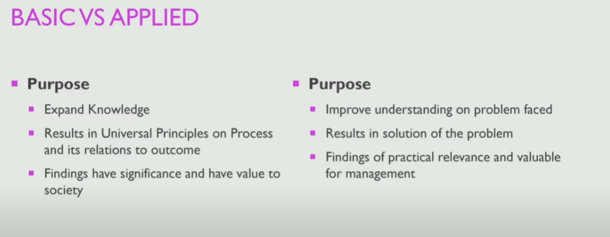
Basic Research & Applied Research

Slide 26
The Research Process
Stages of Research Methodology
Formulating and clarifying a topic
Reviewing the Literature
Design the research
Collecting Data
Analyzing
Writing

Slide 27
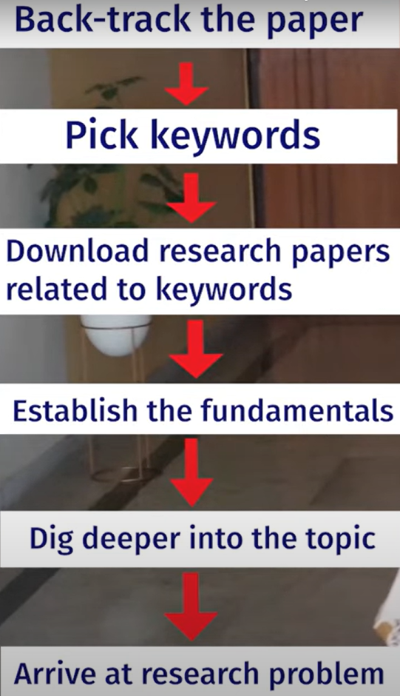
Selecting a Topic

Slide 28
Formulating and clarifying a topic
• Identify the attributes of a good research topic
• Generate and refine research ideas to choose a suitable research topic;
• Turn your research idea into a research project that has a clear research question(s), aim and objectives;
• Understand the relationship between a research question(s), a research aim and research objectives;
• Recognise the role of theory in developing a research question(s), a research aim and research objectives;
• Draft a research proposal that outlines your proposed research project.

Slide 29
Attributes of a good research topic
Capability: is it feasible?
✔ Is the topic something with which you are really fascinated?
✔ Do you have, or can you develop within the project time frame, the necessary research skills to undertake the topic?
✔ Is the research topic achievable within the available time?
✔ Will the topic still be current when you finish your project?
✔ Is the topic achievable within the financial resources that are likely to be available?
✔ Are you reasonably certain of being able to gain access to data you are likely to require for this topic?
Appropriateness: is it worthwhile?
✔ Does the topic fit the specifications and meet the standards set by the examining institution
✔ Does your topic contain issues that have a clear link to theory?
✔ Are you able to state your research question(s), aim and objectives clearly?
✔ Will your proposed research be able to provide fresh insights into this topic?
✔ Does your topic relate clearly to the idea you have been given (perhaps by an organisation)?
✔ Are the findings for this topic likely to be symmetrical: that is, of similar value whatever the outcome?
✔ Does the topic match your career goals? ?

Slide 30
Writing Research Proposal

Slide 31
Writing your research proposal
The research proposal, occasionally referred to as a protocol or outline, is a structured plan of your proposed research project.

Slide 32
Why is a research proposal necessary?
Your research project is likely to be a large element in your course. It is also yours! You will be responsible for conceiving, conducting and concluding this project and creating the report, dissertation or thesis. Apart from applying your research methods training and the advice you receive from your project tutor, it will be your piece of work. From this perspective, developing a research proposal offers you the opportunity to think carefully about your research project
A well-thought-out and well-written research proposal has the potential to provide you with a clear specification of the what, why, how, when and where of your research project.
Producing a research proposal is demanding: thinking through what you wish to do and why, identifying and synthesising literature and then envisaging all of the stages of your research will be time consuming, as will the necessary revisions to create a coherent and clearly written proposal.
However, the effort is likely to prove to be very worthwhile. As you juggle several activities during the period of your research project, there may be occasions when you pick up your research proposal and feel glad that you spent so much time producing a clear specification to guide your project through its various stages.

Slide 33
Meeting the requirements of those who approve and assess your project
It is likely that your research proposal will be assessed before you are allowed to carry on with your research project. A proportion of the overall marks available for your project report may be given for the research proposal.
Alternatively, a research proposal may be subject to approval before you are permitted to proceed with your research project. In either case, it will be necessary to reach a certain standard before being allowed to progress. There are potentially a number of different criteria that may be used to assess a research proposal. These may include criteria that are specific to each of the components of the proposal. Part of the assessment and approval process may also centre on criteria that focus on more general concerns.
We first consider three such criteria that are likely to be used to assess your research proposal: coherence, ethical clearance and feasibility.

Slide 34
Coherence
A research project is a complex and time-consuming activity. As we indicated earlier, you are likely to benefit from creating a clear specification to guide your research project. Your project tutor and any other assessor will be looking for evidence of coherence and lucidity in the way you have written your research proposal, to demonstrate that it will be fit for purpose and able to direct your research activity. Coherence refers to the logical and orderly connection between different components and sections of the proposal.

Slide 35
Ethical clearance
Part of the approval process for your research proposal may involve it being considered and approved by a research ethics committee. Your university’s code of ethical practice is likely to require all research involving human participants to be considered and approved, especially where research involves young or vulnerable participants. It may also be necessary to state how data will be stored, whether they will be kept subsequently and under what conditions, in order to ensure the continuing anonymity of the participants and confidentiality of their data.
You will need to be aware of and abide by the ethical requirements of your institution. These requirements will add to the time that you will need to allow for the planning stage of your research project.
As a professional student you may also need to be aware of and abide by the ethical requirements of your professional institute.

Slide 36
Feasibility
You may have devised a coherent and well-structured research proposal that would create much interest but it may not be possible to achieve, or sensible to contemplate.
Feasibility is a multifaceted criterion that your assessors will be concerned about. Your proposal may not be possible to achieve in the time available to undertake the research project and produce your dissertation or management report. It may be that data collection would not be possible because you would not be able to gain access to participants, or it might not be practical and your tutor will tell you so!
The proposal may require resources that are not available, finance commitments that are unaffordable or skills that you have not developed and would not be able to acquire in the timescale of the project.
It is always helpful to discuss your research proposal with a tutor. Where there are concerns about any of the issues just considered, it will be possible to discuss these to work out how the proposed research may be amended. For example, in relation to feasibility something more modest in scope may be discussed. Your task will then be to amend initial ideas and convince your tutor that the proposed research is achievable within the time and other resources available.

Slide 37
Ensuring that your research project isn’t based on preconceived ideas
Your research project offers a valuable way to learn the skills involved in this activity. These skills are transferable to many other situations, including the world of work. It is about process as well as outcome.
Do not be like the student who came to Phil to talk over a research proposal and said, ‘Of course, I know what the answer will be’. When asked to explain the purpose of doing the research if he already knew the answer, he became rather defensive and eventually looked for another supervisor and, probably, another topic.
Approval of your research proposal implies that it is satisfactory. While this is no guarantee of subsequent success, it will reassure you to know that you have started your research journey with an appropriate destination and journey plan. It will be for you to ensure that you do not get lost!

Slide 38
How may your research project be structured?
There are potentially different ways to structure your research proposal. Different research traditions may lead to different ways of structuring your proposal and, later on, your project report. The followings describe what may be thought of as the standard approach to structuring your research proposal.
You will need to make yourself aware if there is any variation to this in your institution’s or faculty’s requirements. Whichever structure you are required to adopt, this will be driven by and focused on your research question, aim and research objectives, and you will need to ensure that you produce a coherent proposal.

Slide 39
The importance of developing valid research proposal as the foundation for a research project
A good project proposal title should meet the following criteria:
  Specific and accurate
  Not too long
  Contain the main idea
The proposal is one that has an existing body of literature or source material that can be reviewed.
The proposal extends a current line of learning that will lend itself to further rigorous exploration
Ensure that your proposal is ethical, reliable and valid

Slide 40
Writing your own Research Proposal
Before you can write your research proposal you will need to be aware of Followings:
Available literature and appropriate theory,
The research philosophy and approach that you wish to use,
Your research design including methodological choice,
Research strategy and time frame,
Access and ethical issues,
Sample selection, data collection methods and data analysis techniques.

Slide 41
General Contents of Research Proposal
Title
Background/ Introduction
Research Question/s
Rationale/Why?
Aim & Objectives
Methodology/ Approach
Expected Outcome
Schedule/ Timeline (Gantt Chart)
Reference

Slide 42
Contents of Research Proposal – Pearson Set
Title, objective, responsibilities
Title or working title of research project (in the form of a question, objective or hypothesis): Research project objectives (e.g. what is the question you want to answer? What do you want to learn how to do? What do you want to find out?):
Reasons for choosing this research project
Reasons for choosing the project (e.g. links to other subjects you are studying, personal interest, future plans, knowledge/skills you want to improve, why the topic is important)
Literature sources searched
Use of key literature sources to support your research question, objective or hypothesis

Slide 43
Activities and timescales
Activities to be carried out during the research project (e.g. research, development, analysis of ideas, writing, data collection, numerical analysis, tutor meetings, production of final outcome, evaluation, writing the report) and likely durations
Research approach and methodologies
Type of research approach and methodologies you are likely to use, and reasons for your choice: What your areas of research will cover

Slide 44
The purpose and significance for research question and hypothesis
A research question will allow you to say what the issue or problem is that you wish to study and what your research project will seek to find out, explain and answer. One of the key criteria of your research success will be whether you have developed a set of clear conclusions from the data you have collected. The extent to which you can do that will be determined largely by the clarity with which you have posed your research question.
Research question will be at the centre of your research project. It will influence your choice of literature to review, your research design, the access you need to negotiate, your approach to sampling, your choice of data collection and analysis methods, and help to shape the way in which you write your project report. This overarching research question is sometimes referred to as a ‘general research question’, ‘general focus research question’ or ‘central research question’.

Slide 45
Hypothesis
A hypothesis is a testable statement that predicts the relationship between variables based on the research question. It’s a proposed explanation made on the basis of limited evidence that can be proven or disproven through research and experimentation.
There are usually two types of hypotheses:
Null Hypothesis (H0): Suggests that there is no effect or relationship between variables.
Alternative Hypothesis (H1 or Ha): Suggests that there is an effect or relationship between variables.

Slide 46
Title
The title should simply and concisely summarise the research question. It should avoid unnecessary phrases such as, ‘A study to explore ...’ Instead it should reflect the concepts or variables in your research. If your research question changes, this will naturally lead to a change to your title.

Slide 47
Background
This section has a number of related functions. It needs to introduce the reader to the research issue or problem. This addresses the question, ‘what am I going to do?’ You also need to provide a rationale for your proposed research and to justify this. This may be composed of two elements, one relating to you and the other relating to the value of the work.
Your reader will be looking for some evidence that this is a topic in which you have sufficient interest to sustain the effort that will be required from you over the period of the research project.
This may relate to the need to tackle a problem, to your intellectual curiosity, or to your intended career direction. It relates to the question, ‘why am I going to do this?’ The rationale will also need to address the question, ‘why is it worth doing?’
This will relate to one of the following types of justification: the application of a theory to a particular context (such as within an organisation); the development of a theory within a research setting; testing a theory within a given context. Your research may propose other such justifications depending on its nature.

Slide 48
This leads to another function of this section: to demonstrate ‘how my research relates to what has been done before in this subject area’. In achieving this you will show your knowledge of relevant literature and clarify where your proposal fits into the debate in this literature. You will also be able to begin to show ‘which theory or theories will inform what I am doing and how I will use it or them’.
The intention will be not to write a detailed review of the literature but rather to provide an overview of key literature sources from which you will draw and the theory or theories within them. This will not be the same as the critical literature review that you will present in your final project report but the start of the process that leads to it.

Slide 49
Example: Background/Problem Statement:
With the rapid urbanization of the XYZ region, there has been a corresponding surge in traffic congestion, leading to increased air pollution and decreased quality of life for residents. Current transportation infrastructure is ill-equipped to handle this growth, resulting in significant economic and environmental consequences. Existing studies (cite references) indicate a pressing need for sustainable urban mobility solutions to alleviate congestion, reduce emissions, and enhance overall urban livability. This proposal aims to address these challenges by implementing a comprehensive public transportation improvement project."
In this example, the background provides context for the identified problem of traffic congestion and its associated consequences. It cites existing literature to emphasize the urgency of the issue and clearly connects the problem to the proposed project's goals.

Slide 50
Research questions, aim and objectives
The Background section should lead logically into a statement of your research question, aim and research objectives. These should leave the reader in no doubt about what your research seeks to achieve. Be careful here to ensure that your objectives are precisely written and will lead to observable outcomes.
The aim is a concise and overarching statement that outlines the primary goal or purpose of the proposed project. The aim provides a broad perspective on what you intend to achieve, serving as the guiding principle for the specific objectives and activities outlined in your proposal.

Slide 51
Example: Aim
  Begin the aim with a verb that conveys action and purpose. For example: "To develop," "To investigate," "To enhance," etc.
  Follow the action verb with a description of the main goal or outcome.
Example: "To develop an innovative, sustainable waste management system that reduces landfill waste by 50% in the local community within the next two years."
In this example, the aim is specific (developing a waste management system), measurable (reducing landfill waste by 50%), achievable (within the next two years), and aligned with the broader goal of promoting sustainability.
The aim sets the stage for the rest of your proposal, guiding the formulation of specific objectives and the development of a detailed project plan. It should capture the essence of why the project is being undertaken and what it aims to accomplish.

Slide 52
Example: Objectives
Specific
Measurable
Achievable
Relevant
Time-bound

Slide 53
Methodology
The Background and Method will be the longest sections of your proposal. The Method is designed to answer the question, ‘how shall I conduct my research?’ The Method may be divided into sub-sections that deal with research design, participants, techniques and procedures and ethical considerations. This final element may need to be dealt with in a discrete section of your research proposal.
Research design involves you making a number of decisions about, ‘what is my research design?’ You will need to make a methodological choice between a quantitative, qualitative or multiple methods design. You will also need to select one or more research strategies (e.g. an experiment, a case study, a survey, a Grounded Theory strategy) and determine an appropriate time frame for your project depending on the nature of your research. You will need to describe each of these and justify your choice by the way these elements fit together to form a coherent whole.

Slide 54
Methodology
How you design your research will affect the type of data you require, where you intend to locate them and from whom you will collect them. Your data may be collected from human participants, or they may be secondary data such as from archival research or a combination of these.
You will therefore need to address the question, ‘what type of data do I need?’ If you are using secondary data you will need to explain what these are, where they are located, any issues related to access and justify this choice. If you intend to collect data from human participants, you will need to answer, ‘who and where are my intended participants?’
You may be intending to conduct research in a single organisation or across a number of organisations. You will need to explain and justify the nature of the organisation or organisations and possibly the sector or sectors within which it operates (or they operate). Your intended participants may be located within a specific part of an organisation or be drawn from across it. You will need to explain and justify this.

Slide 55
Methodology
You will also need to explain the nature of your research population and why you chose it. For example, they may be entrepreneurs, managerial employees, non-managerial employees, a particular occupational group, trade union officials or some combination of these. Where you need to select a sample from within a research population you will need to address the question, ‘how shall I select them?’
You will also need to describe the data collection and analysis techniques you intend to use by answering the questions, ‘how will I collect my data?’ and ‘how will I analyse it and use this to develop theoretical explanations?’ Data collection techniques include examination of secondary data, questionnaires, interviews and observation.
You will not need to explain the precise details of the technique you intend to use, such as including a copy of your questionnaire, interview questions or the content of an observation schedule but you will need to describe how you will use it.
For example, if you are using interviews, what type will you use, how many will you conduct, with what type of participant, their intended duration, how will you record the data (e.g. note taking and/or audio-recording). You will also need to describe briefly, how you intend to analyse each type of data that you collect.

Slide 56
Methodology
It will also be important to discuss ethical considerations so that you anticipate these and demonstrate to your tutor and ethics committee that your research design and proposal has been formulated to minimise ethical concerns and avoid unethical practice.
This will be essential where you are dealing with human participants, and sometimes even if using secondary data already collected from human participants.
There may be a reduced need for some of you undertaking certain types of research (e.g. where this is based on macro-level, completely anonymised data) but in nearly all cases this requirement is very likely to mean that you need to be sensitive to ethical concerns.

Slide 57
Timescale
This will help you and your reader to decide on the viability of your research proposal. It will be helpful if you divide your research plan into stages. This will give you a clear idea as to what is possible in the given timescale. Experience has shown that however well the researcher’s time is organised, the whole process seems to take longer than anticipated.
As part of this section of their proposal, many researchers find it useful to produce a schedule for their research using a Gantt chart. Developed by Henry Gantt in 1917, this provides a simple visual representation of the tasks or activities that make up your research project, each being plotted against a timeline. The time we estimate each task will take is represented by the length of an associated horizontal bar, while the task’s start and finish times are represented by its position on the timeline.

Slide 58
Resources
This is another facet of feasibility. Including this discussion in your research proposal will allow you and your tutor to assess whether what you are proposing can be resourced. Resource considerations may be categorised as finance, data access and equipment.
Conducting research costs money. This may include for example: travel, subsistence, help with data entry or transcription, or postage for questionnaires. Think through the expenses involved and ensure that you can meet them.
Assessors of your proposal will need to be convinced that you have access to the data you need to conduct your research. This may be unproblematic if you are carrying out research in your own organisation. Many academic committees wish to see written approval from host organisations in which researchers are planning to conduct research. You will also need to convince your reader of the likely response rate to any questionnaire that you send.
It is surprising how many research proposals have ambitious plans for large-scale data collection with no thought given to how the data will be analysed. It is important that you convince the reader of your proposal that you have access to the necessary computer software to analyse your data.
Moreover, it will be necessary for you to demonstrate that you have either the necessary skills to perform the analysis or can learn the skills in an appropriate time, or you have access to help.

Slide 59
References
It is not necessary to try to impress your proposal reader with an enormous list of references. A few key literature sources to which you have referred in the background section and which relate to the previous work and theory that directly informs your own proposal, as well as references to the methods literature, should be all that is necessary.

Slide 60
Use of Saunders’ Research Onion as a guide to establishing a methodological approach.
Saunders' Research Onion is a conceptual framework that helps researchers understand the layers of complexity involved in designing a research project.
It provides a systematic approach to developing a research methodology.
The research onion, developed by Mark Saunders, Philip Lewis, and Adrian Thornhill, consists of different layers, each representing a stage in the research process.
The layers include research philosophy, research approach, research strategy, choices, time horizon, and data collection and analysis techniques/ procedures

Slide 61
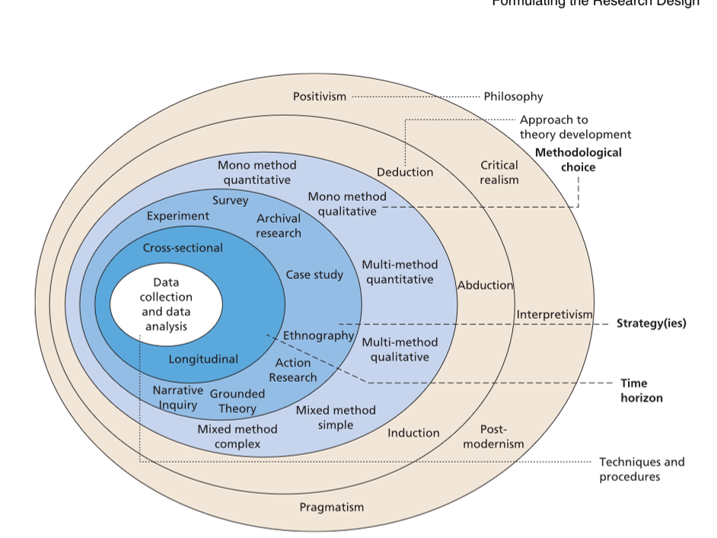

Slide 62
Research Philosophy

